Slide 1



Music Genres for Studying
Team Fog - Christine, Divyansh, Esther
Notes:
Point out briefly - D
<a href="https://www.freepik.com/free-photo/lifestyle-summer-holidays-technology-concept-carefree-happy-handsome-man-close-eyes-feeling-pleased-listening-favorite-song-wireless-headphones-feel-satisfaction-perfect-sound_17118229.htm#query=hearing%20music&position=5&from_view=search">Image by benzoix</a> on Freepik

Slide 2


Our Project: Overview
Team Fog
Target Audience
Our Project
College Students & Working Adults, between age of 18-29 that use music to focus.
Sketches
Data Source
User testing Plan
Spotify track dataset consists of Spotify music tracks up till the end of 2022.
Popularity, Danceability, Energy, Speechiness, Instrumentalness, Acousticness, and Valence.
Genres: Acoustic, Ambient, Chill, Classical, Deep-House, Electronic, Jazz, Study, and Piano.
User testing Feedback
Final Visualization
Ethical Concerns
Challenges & learnings
Limited scope
Data quality
Qualitative characteristic of elements
Biases
Thank you
Notes:
Our audience are individuals 18-29 that listen to music while studying & have a need to focus.
The age range was chosen based on a Statista’s Global Consumer Survey on Spotify users in the United States which indicated that nearly 40% of Spotify are in this age bracket.
Originally just focused on college students we expanded to include working adults as a small online survey or around 20 people that both college students and non-students use music to focus. The emphasis is on those that listen to music to focus.
-College students were one group as students some students study indicated 17hours per week, (National Survey of Student Engagement ) which includes hw, reading and completing assignments. Of course there are some that study more and some that don't study at all.
Listening to music while studying is a personal preference. Some individuals find listening to music distracting, while others may find it helps them concentrate.
We also focused on several charactertics and particulary music with no words as research shows that words can be distracting and so are commericals.

Slide 3
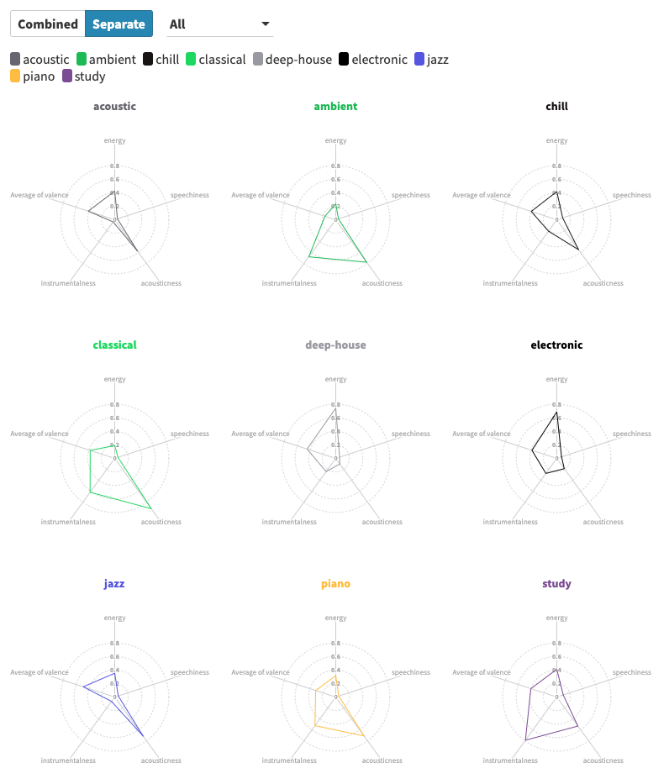
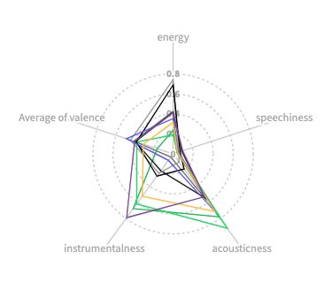
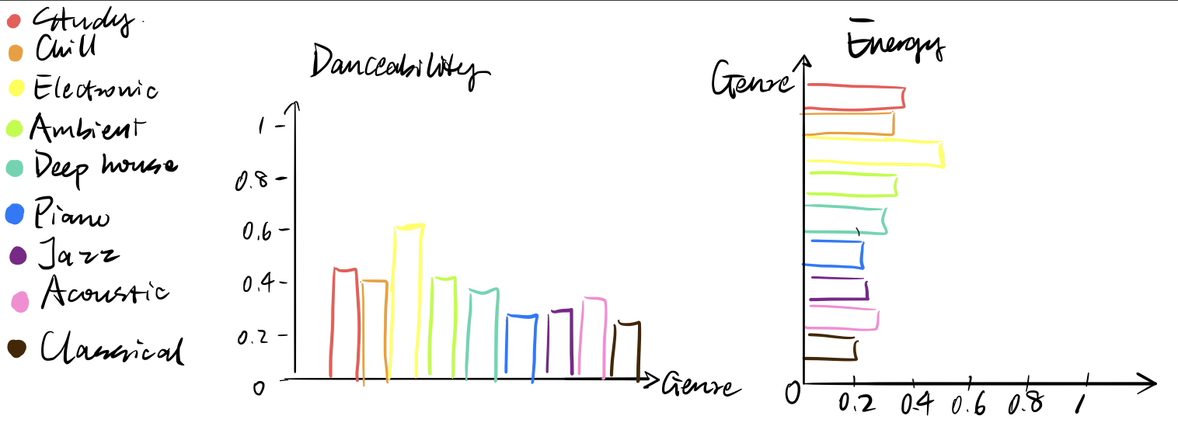
Our Sketches
Team Fog
Our Project
Sketches
User testing Plan
User testing Feedback
Final Visualization
Challenges & learnings
Thank you
Radar Chart
Bar Graph
Notes:
d
Our audience are individuals 18-29 that listen to music while studying & have a need to focus.
The age range was chosen based on a Statista’s Global Consumer Survey on Spotify users in the United States which indicated that nearly 40% of Spotify are in this age bracket.
Originally just focused on college students we expanded to include working adults as a small online survey or around 20 people that both college students and non-students use music to focus. The emphasis is on those that listen to music to focus.
-College students were one group as students some students study indicated 17hours per week, (National Survey of Student Engagement ) which includes hw, reading and completing assignments. Of course there are some that study more and some that don't study at all.
Listening to music while studying is a personal preference. Some individuals find listening to music distracting, while others may find it helps them concentrate. Some of benefits of music include: According to healthline,
“ upbeat music might boost a person’s thinking processes”.
“Instrumental music may be more suitable than songs with lyrics, as the lyrics can be distracting”.
We also focused on several charactertics and particulary music with no words as research shows that words can be distracting and so are commericals.
User testing - We interviewed 5 participants in person using a talk-aloud protocol with open ended questions and tasks. We ordered the questions so task based questions came after open ended questions so that users could make their own insights on the visualization. An example of a task based question is “can you tell me which genres have low levels of speachiness, and are also high levels of energy”
We also had elements of a comparing alternative design study as we showed users multiple charts and asked them for their preference.
“Alternatively, you can ask participants to perform the tasks using one primary design (counterbalancing the designs). and then show the other design alternatives and ask for their preference”( Albert 60).

Slide 4
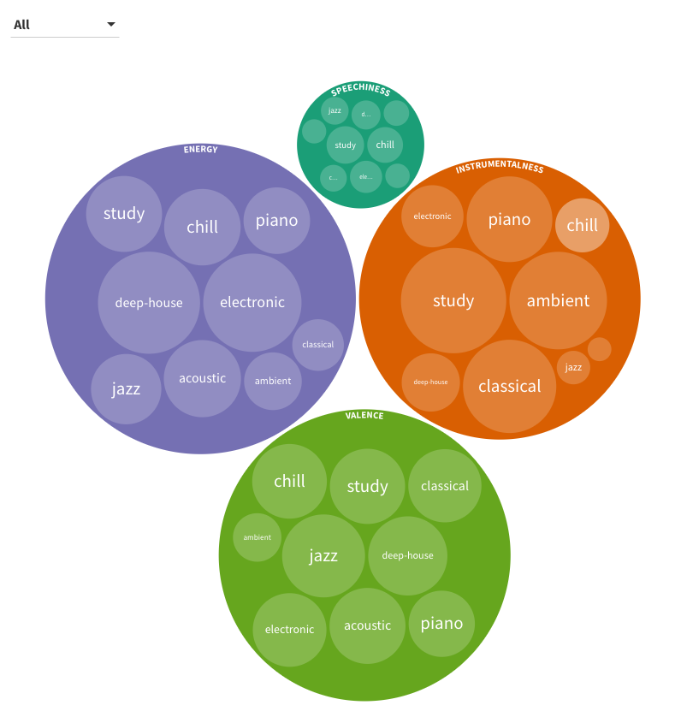
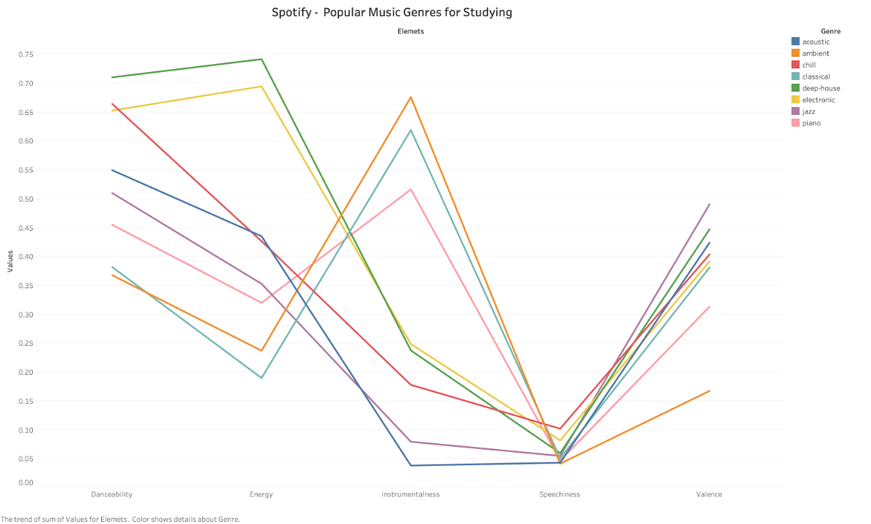
Our Sketches
Team Fog
Our Project
Sketches
User testing Plan
User testing Feedback
Final Visualization
Challenges & learnings
Thank you
Parallel Chart
Bubble Chart
Notes:
d

Slide 5
User Testing Plan
Team Fog
Interview 5 participants who belong to our target audience group
Receive comments on their observations
Perform task to confirm graph choice
Confusion and suggestions
Overall preference on visual representation
Our Project
Challenges
User testing Plan
User testing Feedback
Question Overview
Final Visualization
What the visualization is about?
Do you understand what the audio feature terms mean?
Identify the genre with low speechiness and high energy.
Do you think the visualization is able to give them recommendation?
Challenges & learnings
Thank you
Notes:
our approach is to use a talk-aloud protocol with open ended questions and tasks
4 MSIM students and 1 undergrad senior at UW who listen to music that help them focus when they study
Ask them to provide comments based on their observations to visualizations
Complete one task to confirm if they comprehend the visualization and if we selected the right graph choice
ask about confusion and suggestions, what type of visual representation they prefer
what it is about
what the terms mean
task
for 4&5: ask if our message get delivered well through the graph
if want to use any of this:
User testing - We interviewed 5 participants in person using a talk-aloud protocol with open ended questions and tasks. We ordered the questions so task based questions came after open ended questions so that users could make their own insights on the visualization. An example of a task based question is “can you tell me which genres have low levels of speachiness, and are also high levels of energy”
We also had elements of a comparing alternative design study as we showed users multiple charts and asked them for their preference.
“Alternatively, you can ask participants to perform the tasks using one primary design (counterbalancing the designs). and then show the other design alternatives and ask for their preference”( Albert 60).

Slide 6
User Testing Feedback
Team Fog
Positives
Our Project
Able to identify different audio features’ characteristics
Will consider trying out some genres listed in visualization
Challenges
Negatives
User testing Plan
Need more clarifications on what the audio features mean
Problems with parallel line chart and bubble chart
Values unnecessary to understand the graph
User testing Feedback
Final Visualization
Challenges & learnings
Changes Made
Used bar graph as our final visualization
Thank you
Notes:
E
e.g. identify that the genre ambient is high in instrumentalness and low in energy
determine what types of characteristics in audio features they are looking for (some prefer high energy music) + ~
meanings of valence and speechiness
parallel line: looks like trends, assume that there are correlations between these up and downs among audio features
bubble chart: similar sizes of circles are confusing, not sure why we pull these audio features out for recommendations
dataset use values between 0~1 to evaluate the high and low in audio features for each genre, y-axis of parallel
reflect that they can easily determine the characteristics of the genres when looking at bar chart

Slide 7
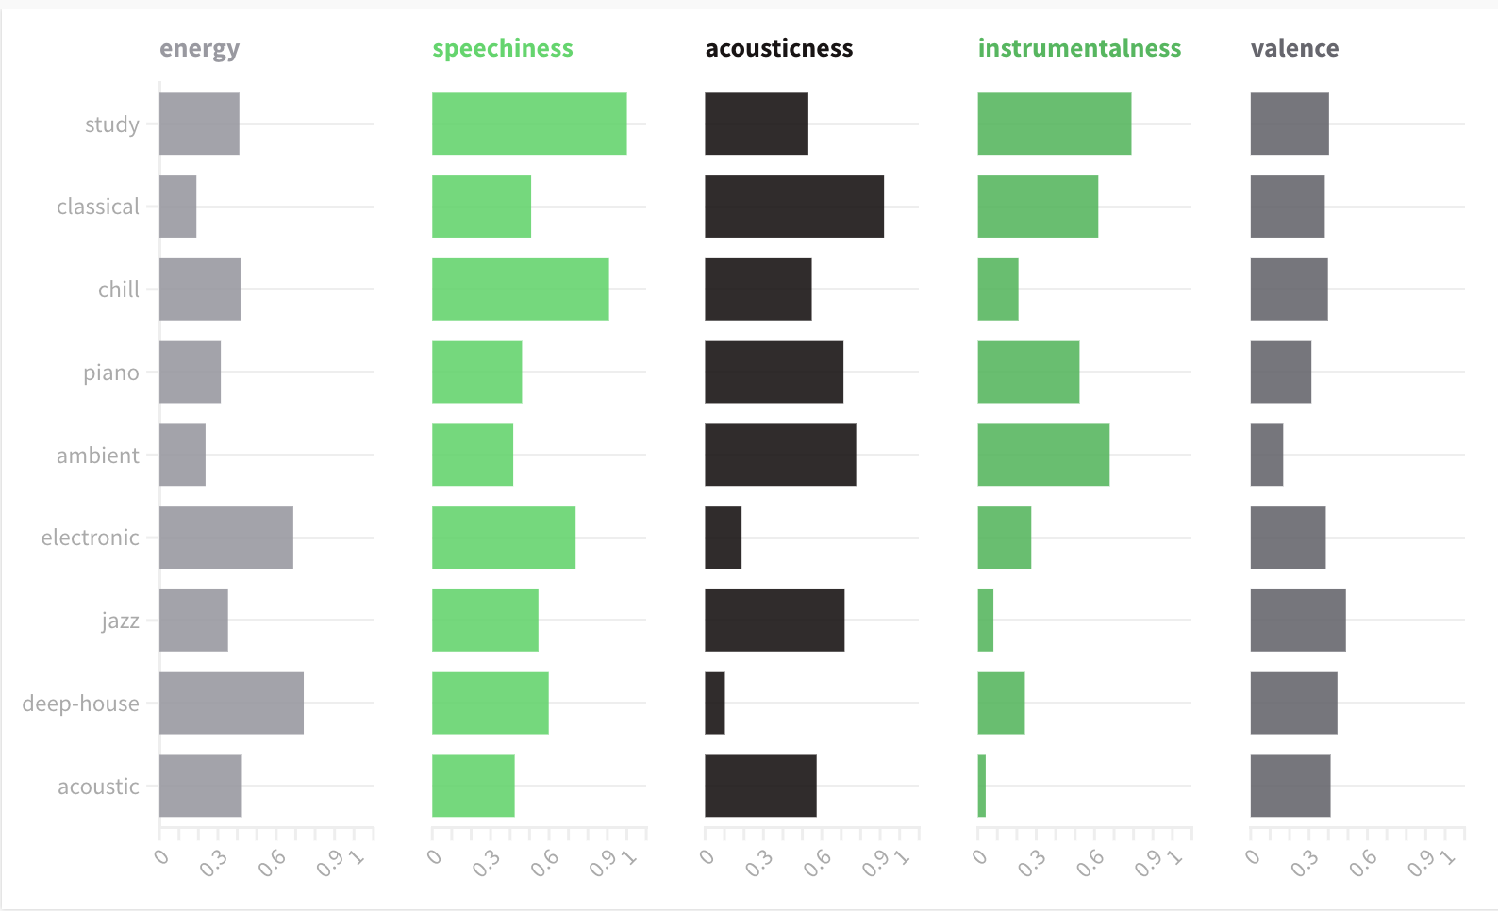
Our Final Visualization
Team Fog
Characteristics of Music Genres
Our Project
Challenges
User testing Plan
User testing Feedback
Genres
Final Visualization
Challenges & learnings
Thank you
Notes:
After considering user testing results of various charts we decided to use a few bar charts. Our design rationle considered comprehension and ease of understanding. We also made use of the pre-attentive visual abilities.
color - Our color choice was based on Spotify’s brand color scheme. AND we also used color differenentiave different categories and characteristics. We counsidered Humans preattentive ability to dintinguish color and to group by color. We were concerned uers might associate or group instrumentalness and speachiness together since they share a similar green color, but this was not an issue during testing. We also choose to reduce the information presented - only a small number of categories as not to overwhelm users.
Length - We choose the bar chart as it utilized length- humans are very good at identifying lenghth andwhich items are longer and shorter. Also we choose not to include numbers indicating levels of energy etc next to the bars as for most users knowing the exact value wasn't important. Cross catergory numberical comparisions might not be relevant either. If a song had an energy score of .9 comparing it to instrumentalism score of .9 wouldnt be meaninful. Left the x- axis values in case a user did want to konw and roughly compare across genres.
Comprehension - This chart type didnt require any advanced data literacy skills. And As you will hear next in the challenges section we focused on readibility vs complexity.

Slide 8
Challenges & Learnings
Team Fog
Challenges:
Data and User Design
Choices
Learnings:
Consider Audience
Our Project
Challenges
Audience Needs vs purely Aesthetic appeal
Determining the right questions to ask our audience and finding the right dataset to answer the questions.
User testing Plan
User testing Feedback
Our preferences in chart type may not align with users
Final Visualization
Challenges & learnings
Choosing the right chart type
Inteneded use vs corporate design
Thank you
Notes:
E Script:
design process: topic first, try possible audience groups while coming up with topic-related questions that people would find interesting to know about
spend a lot of time finding the suitable dataset with the right variables that related to the questions
tried multiple types of graphs, multiple variables, hard to find the right one that can deliver our messages the best to users
C Script:
We learned that we need to focus on audience needs over what looks cool or is most visually appealing. The asthetic appeal does affect the user experience, but if users dont understand the Visualization , its not useful. For example, we experimented with a radar chart but most users were clueless on how to read it. We found that the simplest elements of the bar chart were the most effective. Foucus on user needs and preferences - A chart that we like, may not be what our users like.
Lastly, We also instincitivly focused on design style appropriate for corporate setting, but realized we could be a bit more playful and less formal design style. Realistically, it still has a bit of a corporate appearacne.
Learned:
Consider the audience. -
C) Audience needs over what looks cool or flashy. We experimented with several chart types. - A radar chart that had interactivity, but some users were clueless about how to read. packed bubble that, but the simplest elements - lines in bar charts and lines in a radar chart were most effective. Understandable vs flashy.
Also & learned - make the one-pager design visually suitable for target audience (instead of a professional report)
What we like and expect our users to like wont always be what our users like best
prettier (simpler)graphs would not necessarily make the messages we want to deliver clearer to users

Slide 9

Thank You
S
Slide
Slide Deck adapted from 24 Slides
https://24slides.com/templates/view/other/spotify-themed-powerpoint-template
Notes:
Slide Deck adapted from 24 Slides
https://24slides.com/templates/view/other/spotify-themed-powerpoint-template

